Slide 1
Introduction to GUI Programming
GUI Programming, Part 1
Notes:
A Bayley

Slide 2
Learning Objectives
Students should be able to
  describe the services provided by AWT and Swing
  develop applications using AWT and Swing
  use frames/ contentpanes
  use menu components
use event handlers and are able to implement event handlers in code
Can describe what an actionlistener is and can write code that uses actionlistener’s
Notes:
A Bayley

Slide 3
GUI Principles
Components: GUI building blocks. Individual parts that the interface is build on.
  Buttons, menus, sliders, …
Layout: arranging components to form a usable GUI.
  Using layout managers.
Events: reacting to user input.
  Button presses, menu selections, …
Notes:
We have been creating text based interfaces so far. Because it was easier to create and more focus could be given for OOP concepts that software building issues.
A Bayley

Slide 4
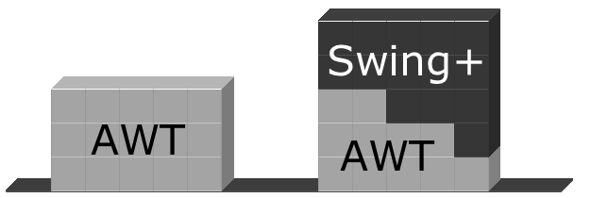
AWT and Swing
AWT
A part of original Java API
Swing
  Uses
  Replaces
  Adds to
AWT classes
Notes:
A Bayley

Slide 5
Top Level Window (Frame)
Every GUI has a top level window
Is under the control of the OS window management system
Can be moved/ resized/ minimised and maximised independently
AWT – Frame
Swing - JFrame

Slide 6
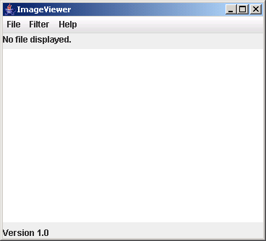
Elements of a frame
Title
Window controls
Menu bar
Content pane
Notes:
A Bayley

Slide 7
Creating a frame
import java.awt.*;
import javax.swing.*;
public class ImageViewer
{
  private JFrame frame;
  /**
  * Create an ImageViewer show it on screen.
  */
  public ImageViewer()
  {
  makeFrame();
  }
  // rest of class omitted.
}
“A Window”
Resizable, borders, window controls
can set a title, size, what should be done on close etc.
Construct the frame and add components
Notes:
A Bayley

Slide 8

The content pane
Components must be added to a contentPane. The frame supplies the contentPane
/**
* Create the Swing frame and its content.
*/
private void makeFrame()
{
frame = new JFrame("ImageViewer");
Container contentPane = frame.getContentPane();
JLabel label = new JLabel("I am a label. I can display some text");
contentPane.add(label);
frame.pack();
frame.setVisible(true);
}
To make the frame visible
To arrange the components in the frame properly
Notes:
Since Java 1.5, you can add components by calling the JFrame add method without adding a contentpane.
frame.add(label);
A Bayley

Slide 9
Alternate way…
import java.awt.*;
import javax.swing.*;
public class ImageViewer extends JFrame
{
public ImageViewer()
{
super("ImageViewer");
makeFrame();
}
private void makeFrame()
{
Container contentPane = getContentPane();
JLabel label = new JLabel("I am a label.");
contentPane.add(label);
pack();
setVisible(true);
}
}
GUI class can be defined as a sub class of JFrame class
Notes:
A Bayley

Slide 10
Menu Components
Menus are added just below the title bar of the frame
To create menus 3 classes are involved
  JMenuBar – Represent a menu bar, placed below the title bar
  Jmenu – Represent a single menu such as File, Help, Edit
  JMenuItem – Represent a single item inside a menu such as open, save

Slide 11
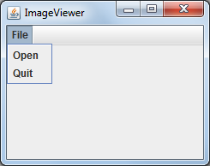
import java.awt.*;
import javax.swing.*;
public class ImageViewer
{
private JFrame frame;
public ImageViewer()
{
  makeFrame();
}
private void makeFrame()
{
frame = new JFrame("ImageViewer");
makeMenuBar(frame);
frame.setVisible(true);
frame.pack();
}
private void makeMenuBar(JFrame frame)
{
JMenuBar menuBar = new JMenuBar();
frame.setJMenuBar(menuBar);
JMenu fileMenu = new JMenu("File");
menuBar.add(fileMenu);
JMenuItem openItem = new JMenuItem("Open");
fileMenu.add(openItem);
JMenuItem quitItem = new JMenuItem("Quit");
fileMenu.add(quitItem);
}
}
Menu
Menu Items
Menu Bar

Slide 12
Event handling
Events correspond to user interactions with components.
Swing uses a event handling model with event listeners to deal with user interactions
Different components are associated with different event types.
  Frames are associated with WindowEvent.
  Menus, Buttons are associated with ActionEvent.
Objects can be notified when an event occurs.
  Such objects are called listeners.
An object that wants to listen to these events must implement ActionListener interface and define actionPerformed() method
Notes:
Different events will be caused by different actions.
When a button is clicked/ menu item is selected – ActionEvent is raised
When a mouse is clicked/ moved – MouseEvent is raised
When a frame is closed – WindowEvent is raised
A Bayley

Slide 13
Centralized event receipt
The listening object
A single object handles all events.
  Implements the ActionListener interface.
  Defines an actionPerformed method.
It registers as a listener with each component.
  item.addActionListener(this)
It has to work out which component has dispatched the event.
Agrees to be an ActionListener
Has a special method
This is just one way of doing this
Notes:
A Bayley

Slide 14
Centralized event receipt
A single object handles all events.
  Implements the ActionListener interface.
  Defines an actionPerformed method.
It registers as a listener with each component.
  item.addActionListener(this)
It has to work out which component has dispatched the event.
The object ( for example a button) that generates the event
The object that will listen for events
Notes:
A Bayley

Slide 15
import java.awt.*;
import javax.swing.*;
import java.awt.event.ActionEvent;
import java.awt.event.ActionListener;
public class ImageViewer implements ActionListener
{
…
public void actionPerformed(ActionEvent e)
{
String command = e.getActionCommand();
if(command.equals("Open")) {
…
}
else if (command.equals("Quit")) {
…
}
…
}
private void makeMenuBar(Jframe frame)
{
…
openItem.addActionListener(this);
…
quitItem.addActionListener(this);
}
}
This class contains both the objects that generate the event and the code that listens for events
Notes:
To make ImageViewer to be a single listener to all events from the menu.
The class must implement the ActionListner interface
The class must define the method – public void actionPerformed(ActionEvent e)
Must call the addActionListner method of the menuItem to register ImageViewer object as a listener.
A Bayley

Slide 16
import java.awt.*;
import javax.swing.*;
import java.awt.event.ActionEvent;
import java.awt.event.ActionListener;
public class ImageViewer implements ActionListener
{
…
public void actionPerformed(ActionEvent e)
{
String command = e.getActionCommand();
if(command.equals("Open")) {
…
}
else if (command.equals("Quit")) {
…
}
…
}
private void makeMenuBar(Jframe frame)
{
…
openItem.addActionListener(this);
…
quitItem.addActionListener(this);
}
}
1. openItem is a menuItem object that generates events
2. This code registers the current object as the object that will listen for events
Notes:
A Bayley

Slide 17
public class ImageViewer implements ActionListener
{
…
public void actionPerformed(ActionEvent e)
{
String command = e.getActionCommand();
if(command.equals("Open")) {
…
}
else if (command.equals("Quit")) {
…
}
…
}
…
private void makeMenuBar(Jframe frame)
{
…
openItem.addActionListener(this);
…
}
}
3. The class becomes a listener for events by implementing the ActionListener Interface
4. The class adds a new method “actionPerformed”
Notes:
A Bayley

Slide 18
public class ImageViewer implements ActionListener
{
…
public void actionPerformed(ActionEvent e)
{
String command = e.getActionCommand();
if(command.equals("Open")) {
…
}
else if (command.equals("Quit")) {
…
}
…
}
…
private void makeMenuBar(Jframe frame)
{
…
openItem.addActionListener(this);
…
}
}
5. When an event is generated
an event object is created
and sent from the object that creates the event
to the actionPerformed method of the object listening
Notes:
A Bayley

Slide 19
public class ImageViewer implements ActionListener
{
…
public void actionPerformed(ActionEvent e)
{
String command = e.getActionCommand();
if(command.equals("Open")) {
…
}
else if (command.equals("Quit")) {
…
}
…
}
…
private void makeMenuBar(Jframe frame)
{
…
openItem.addActionListener(this);
…
}
}
3. After identifying source of event appropriate action can be taken
2. We can find out the objects name
1. The ActionEvent object includes information about which object generates the event
A listening object can be registered with many objects that generate events.
Notes:
Each time the menu is activated the object’s own actionPerformed method is called.
When the actionPerformed method is called the menu item will pass a parameter of type ActionEvent that will provide information (time of the event, command string etc.) about the event that occured to the actionPerformed method.
A command string is a string that identifies the component that the raised the event.
A Bayley

Slide 20
Centralized event handling
The approach works.
It is used, so you should be aware of it.
However …
  It does not scale well.
  Identifying components by their label text is fragile.
  For every additional menuitem we will have to add a condition to the central event handling method
An alternative approach is preferred.
Notes:
Checking the menu item label is not a good idea because the label can be changed anytime causing changes to the centralized method.
A Bayley

Slide 21
Option 2, using an Inner Class
Class definitions may be nested.
  public class Enclosing
  {
  …
  private class Inner
  {
  …
  }
  }
Same as before but
We declare a separate ActionListener class for each object (e.g. menuitem) to be listened to.
The classes are built inside the class with the objects that generate the event
Instances of the inner class have access to the private members of the enclosing class.
Inner classes are normally written at the end of the enclosing class.
Notes:
A Bayley

Slide 22
public class ImageViewer
{
………
private void makeMenuBar(Jframe frame)
{
……
JMenuItem openItem = new JMenuItem(“Open”);
openItem.addActionListener(new OpenActionListener());
fileMenu.add(openItem);
JMenuItem quitItem = new JMenuItem(“Quit”);
quitItem.addActionListener(new QuitActionListener());
fileMenu.add(quitItem);
}
class OpenActionListener implements ActionListener
{
public void actionPerformed(ActionEvent e)
{
………
}
}
class QuitActionListener implements ActionListener
{
public void actionPerformed(ActionEevent e)
{
…………
}
}
}
Enclosing class
Separate anonymous objects to listen to separate menu items
Inner classes

Slide 23
Option 3, Anonymous inner classes
Using inner classes improves cohesion
To improve the previous solution further we could use anonymous inner classes
When creating anonymous inner classes;
  Obey the rules of inner classes.
  Used to create one-off objects for which a class name is not required.
  Use a special syntax.
The instance is always referenced via its supertype, as it has no subtype name.
Ignore this for now, we have not learnt enough
Notes:
A Bayley

Slide 24
Anonymous action listener
This is similar to before
Object generating event
JMenuItem openItem = new JMenuItem("Open");
openItem.addActionListener(new ActionListener() {
public void actionPerformed(ActionEvent e) {
openFile();
}
});
This is the new part, in the previous examples we used “this” in this spot.
Call to method to register listener
Notes:
A Bayley

Slide 25
Anonymous action listener
1. Create a new object
JMenuItem openItem = new JMenuItem("Open");
openItem.addActionListener(new ActionListener() {
public void actionPerformed(ActionEvent e) {
openFile();
}
});
Method to be called if event received
2. Define the required method
This is very cohesive and extendable.
Adding a new menu item is very easy.
But code may be difficult to read.
Notes:
Can we create objects from an interface?
No. The code above creates an object from an anonymous class, which implements the interface. Under the covers, the JVM actually creates a class implementing the interface, and then creates an instance of that class
A Bayley

Slide 26
Anonymous class elements
A different view of exactly the same code
Anonymous object creation
openItem.addActionListener(
  new ActionListener()
  {
  public void actionPerformed(ActionEvent e)
  {
  openFile();
  }
  }
);
Class definition
Actual parameter
Notes:
A Bayley

Slide 27
Layout Managers
Layout managers are used to arrange components of the GUI
Each container that holds components has an associated Layout manager that takes care of arranging the components
Swing provides different layout managers
    Flow Layout
    Border Layout
    Grid Layout
    Box Layout
frame.setLayout(new FlowLayout());
Notes:
Flow Layout – Arrange components left to right
Border Layout – Places components in a pattern (centre, north, east, west, south)
Grid Layout – Components will be resized to the width of the widest
Box Layout – Lays components vertically/ horizontally
A Bayley

Slide 28
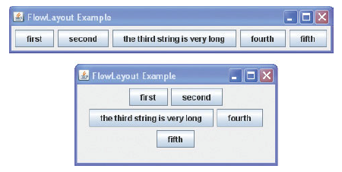
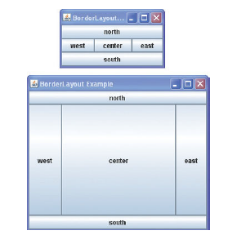
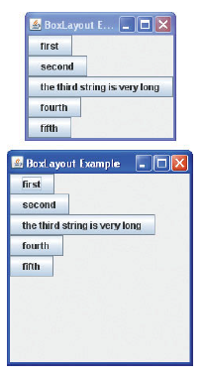
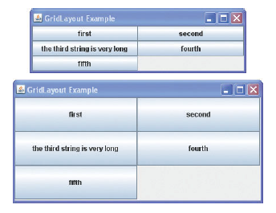
Layout Managers
Flow Layout
Border Layout
Grid Layout
Box Layout
Notes:
As a rule, the only containers whose layout managers you need to worry about are JPanel and Content Pane. Each JPanel object is initialized to use a FlowLayout, unless you specify differently when creating the JPanel. Content panes use BorderLayout by default.
A Bayley

Slide 29
Reading & Exercises
Read BlueJ text, Chapter 11
Explore some swing tutorials
  http://java.sun.com/docs/books/tutorial/uiswing/components/index.html
Notes:
A Bayley

Slide 30
References
BlueJ Text, Barnes and Kolling

